Slide 1

Final Year Project On,
MIMO Antenna in
5G Communication
Presented by:
Nabanita Saha (T91/ECE/184047)
Tamojit Das (T91/ECE/184052)
Under supervision of:
Dr. Kaushik Mandal (Assistant. Professor, RPE, CU)
Institute of Radiophysics and Electronics
University of Calcutta
June 2022

Slide 2
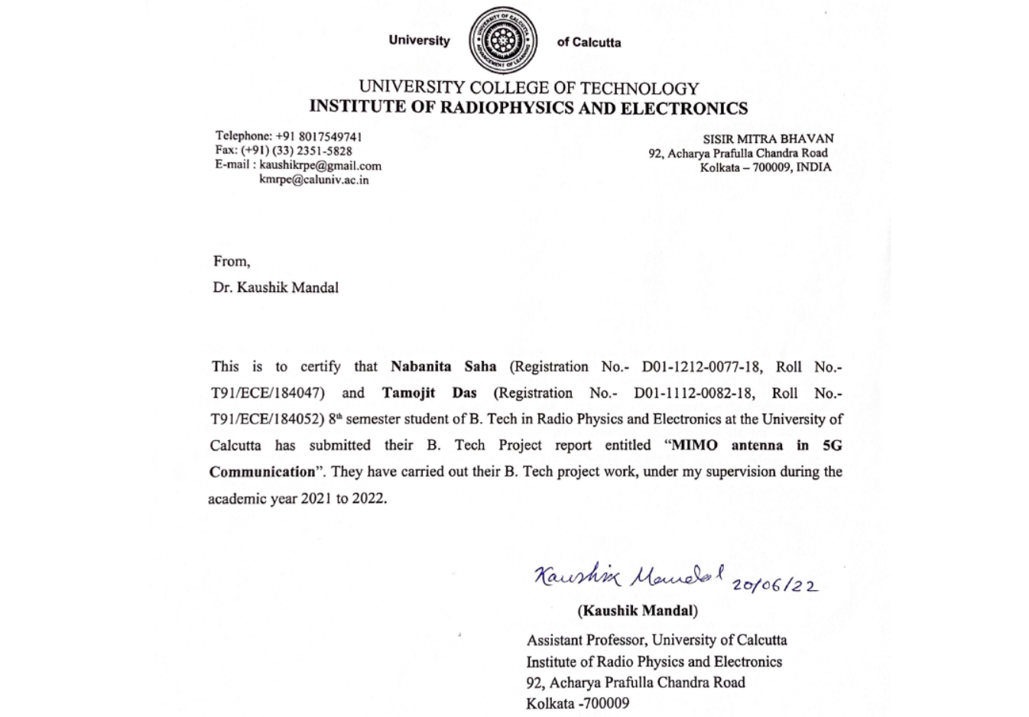

Slide 3
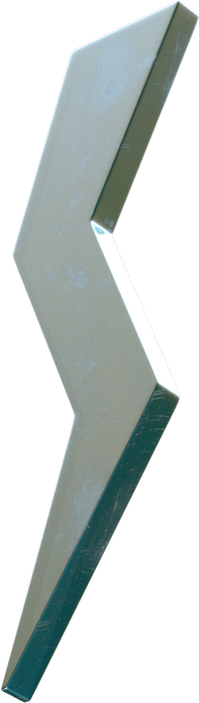
Outline
Motivation and Objective
What is MIMO technology?
Literature Review
Proposed MIMO antenna
Design evolution and corresponding antenna performance
Parametric Studies
Radiation Pattern, ECC, DG
Fabricated Prototype and
Measured Results

Slide 4
Motivation
Increased demand of 5G usage
MIMO antenna is the obvious choice for the 5G applications
Mutual coupling among the antenna elements is the key factor for a MIMO antenna
Enough scope is there to work with the placement of antenna elements for better isolation
Objective
Design and analysis of MIMO antenna for 5G applications
Sub 6 GHz band is the target operating band
Improvement of isolation between the antenna elements
Design that can provide both space and pattern diversity

Slide 5
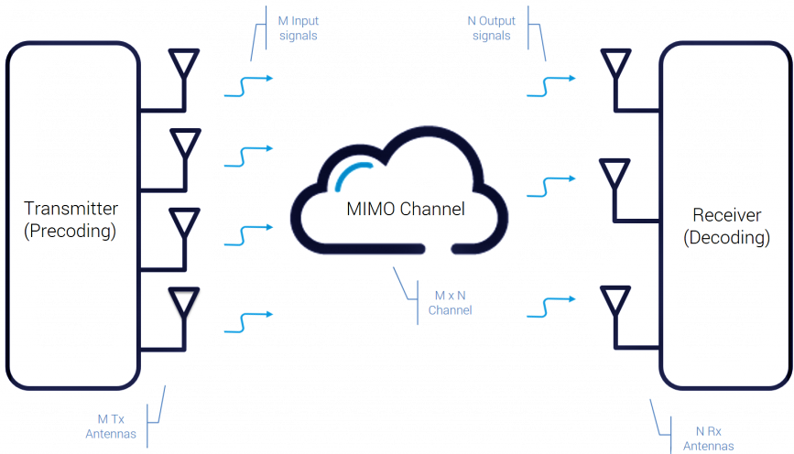
What is MIMO Technology ?
MIMO (multiple input, multiple output) is an antenna technology for wireless communications in which multiple antennas are used at both the source (transmitter) and the destination (receiver).

Slide 6
Proposed
MIMO Antenna
With Better Isolation

Slide 7
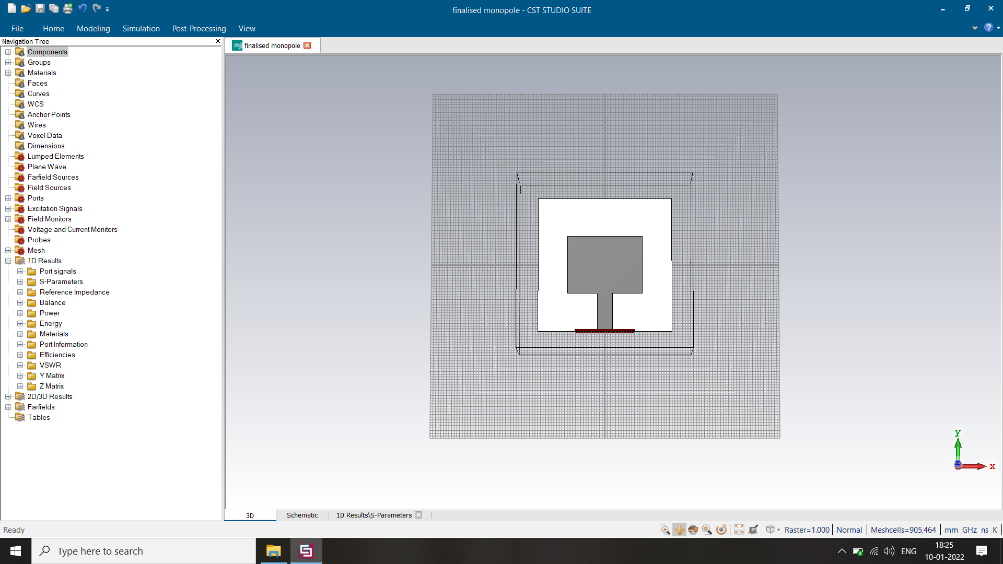
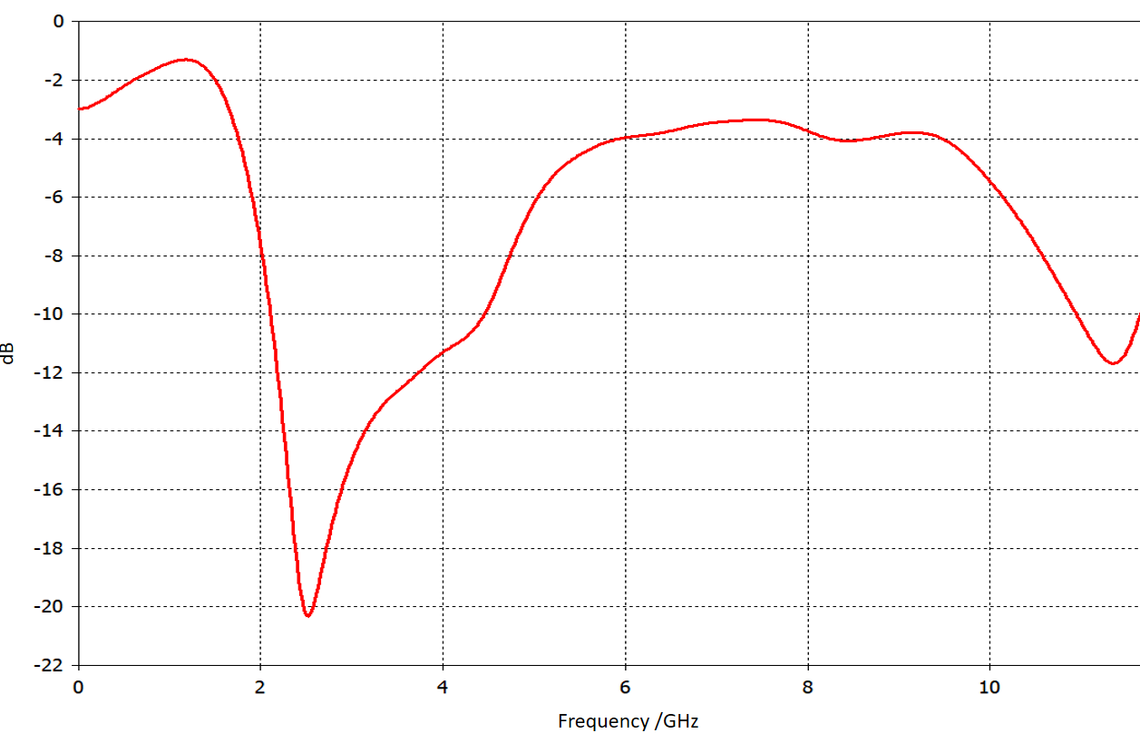
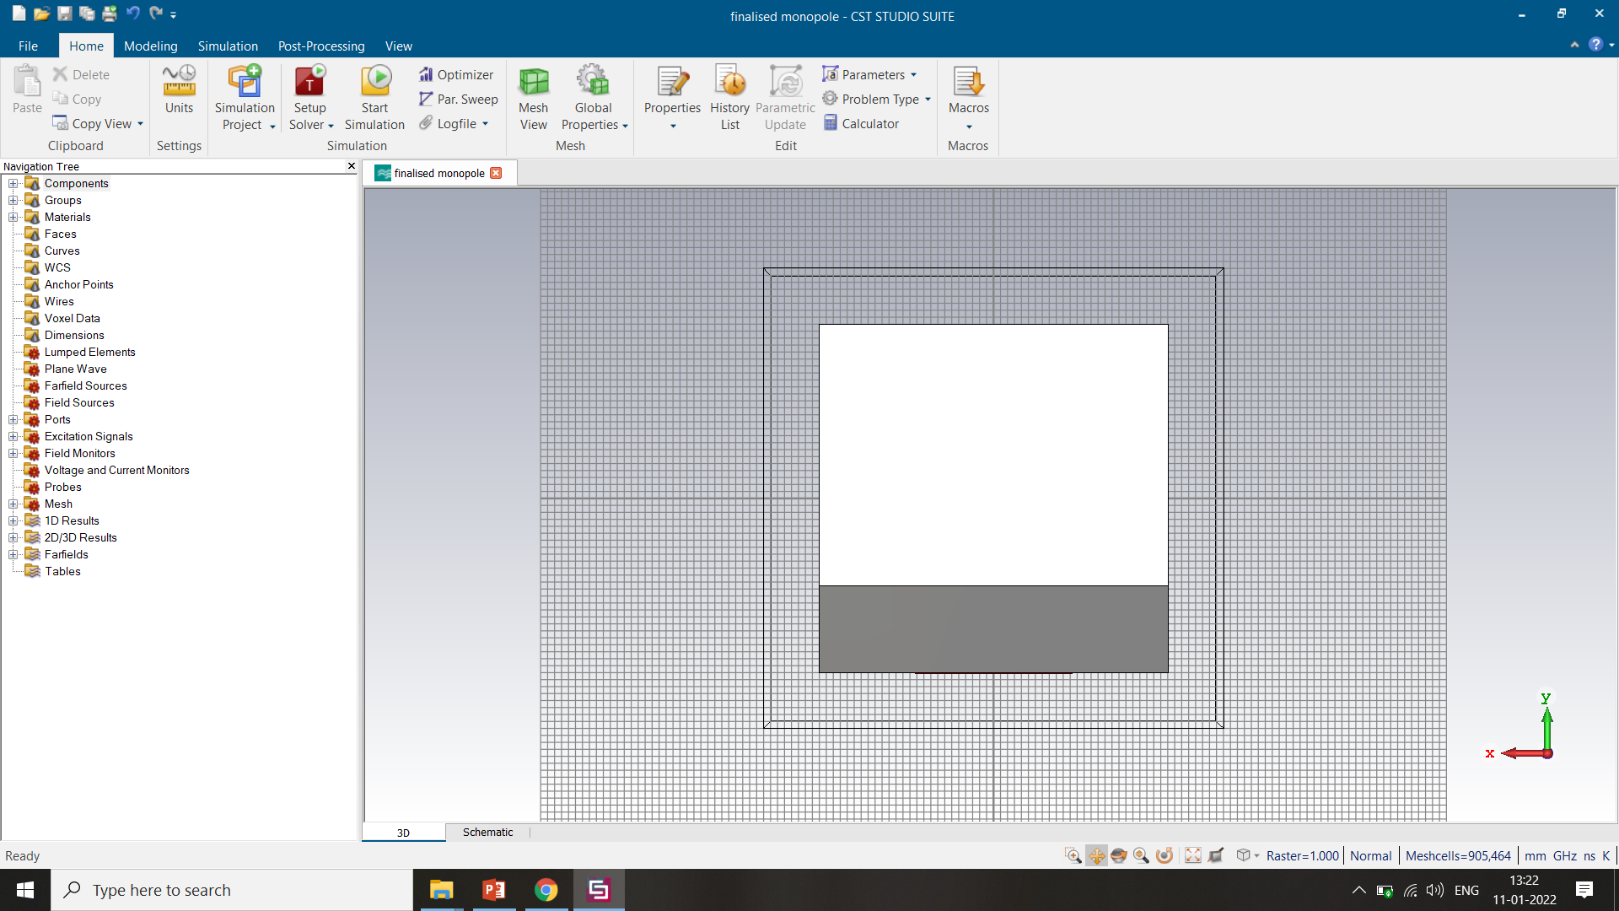
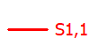
Design 1: Single Monopole
Design Parameters:
Antenna Patch
Length = 21.484023919693 mm,
Width = 27.922505310634 mm,
Height = 0.035 mm
Feed Line
Length = 14.5 mm,
Width = 5.5845010621268 mm,
Height = 0.035 mm
Materials Details:
Dielectric Material – FR4
Patch and Ground – Copper
Front View
dB
Operating band: 2.1087 – 4.4534 GHz
Band Width : 2.3447 GHz
Frequency /GHz
S-parameter (S₁₁)
Back View
* (Design Parameters and Materials Details are same for all 4 designs)

Slide 8
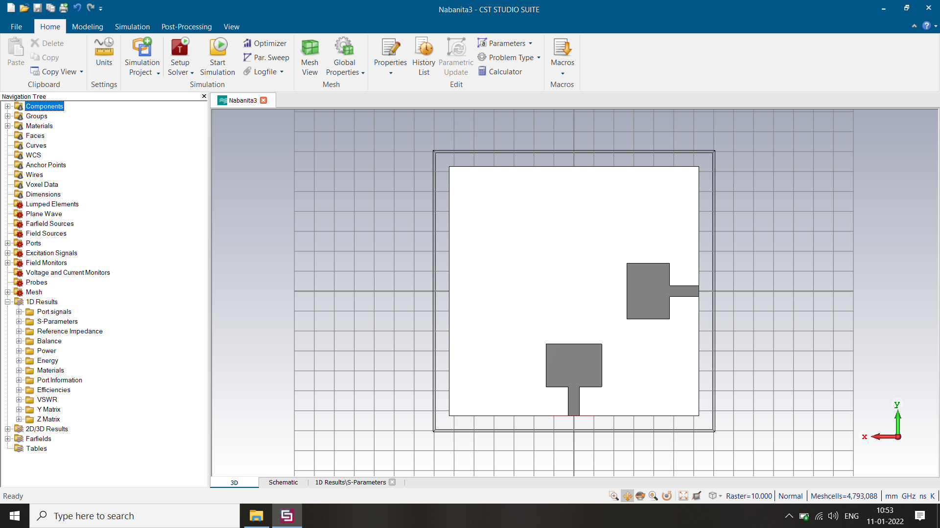
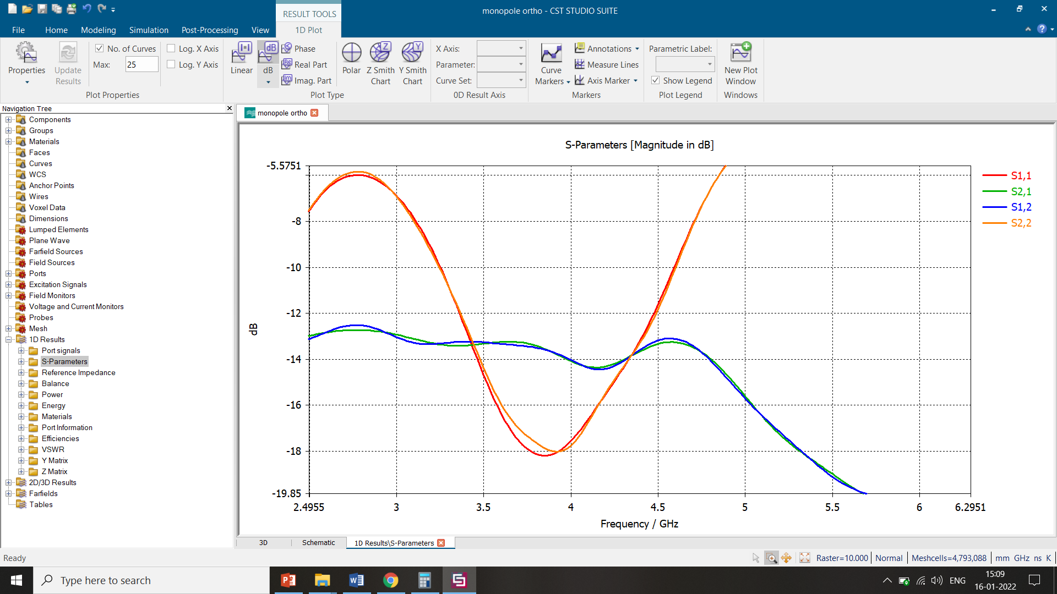
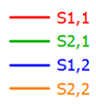
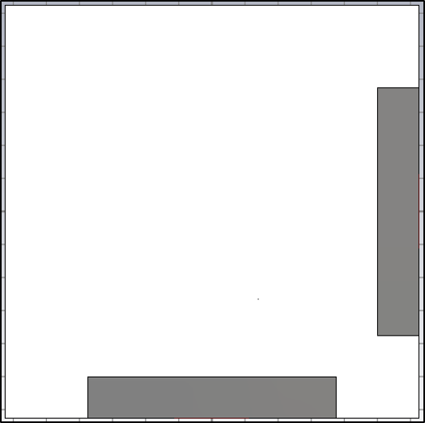
Design 2: Orthogonal placement of Two Monopoles
Front View
Back View
Operating Band: 3.2505 – 4.6002 GHz
Band Width: 1.3497 GHz
Maximum S21: -13 dB
S-parameters

Slide 9
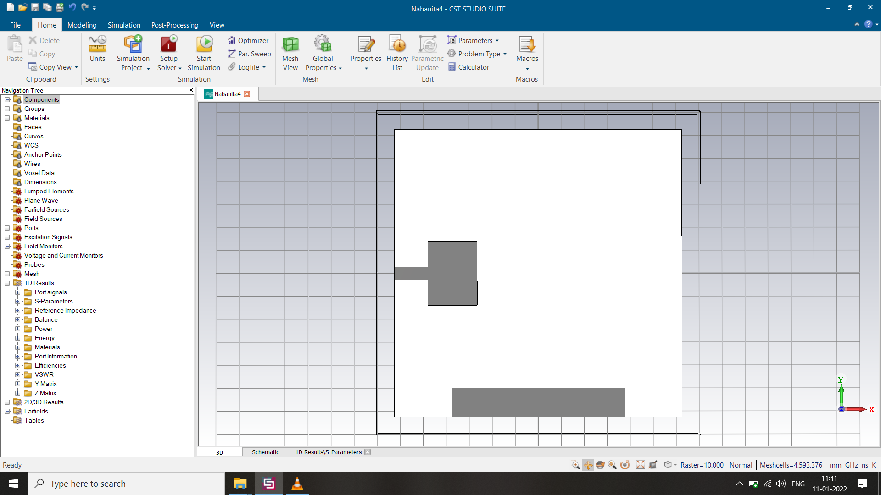
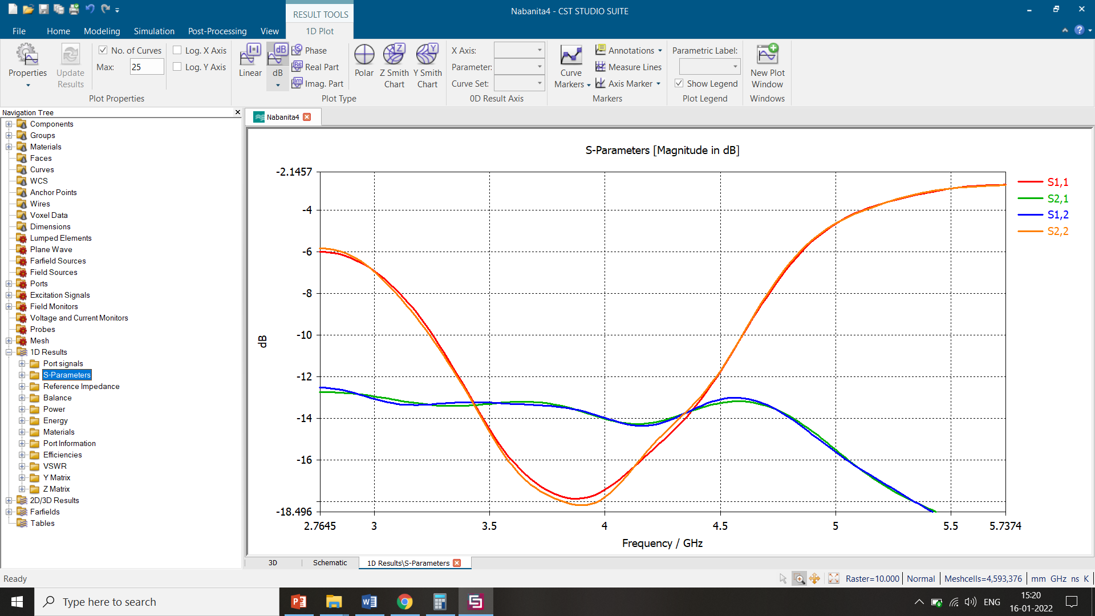
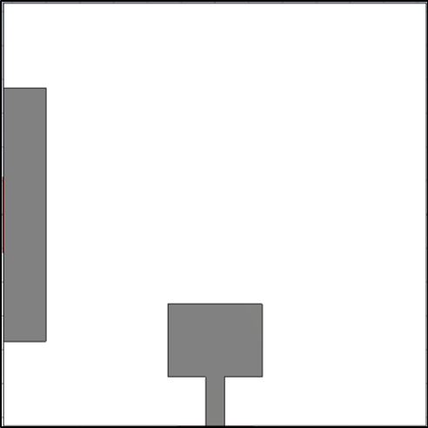
Design 3: Two Monopoles orthogonally opposite side of the Substrate
Front View
Back View
Operating Band: 3.2396 – 4.5971 GHz
Band Width: 1.3575 GHz
Maximum S21: -13.5 dB
S-parameters

Slide 10
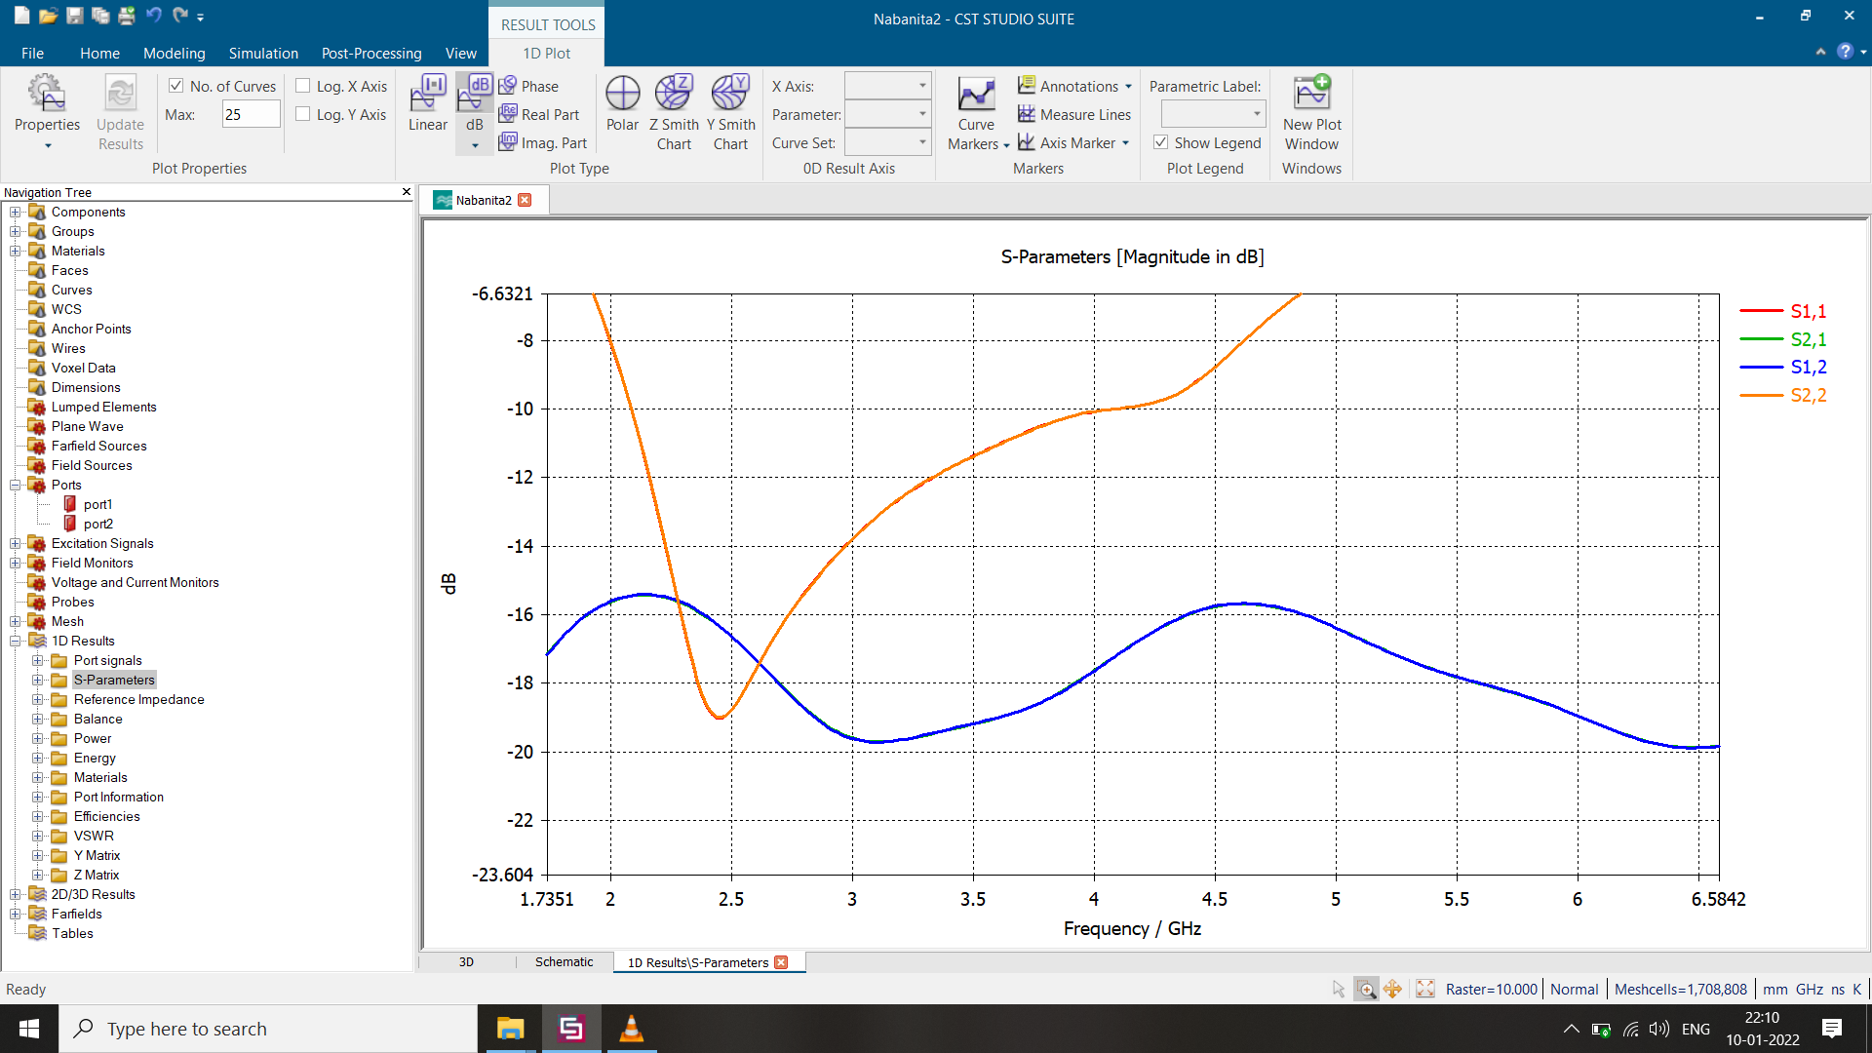
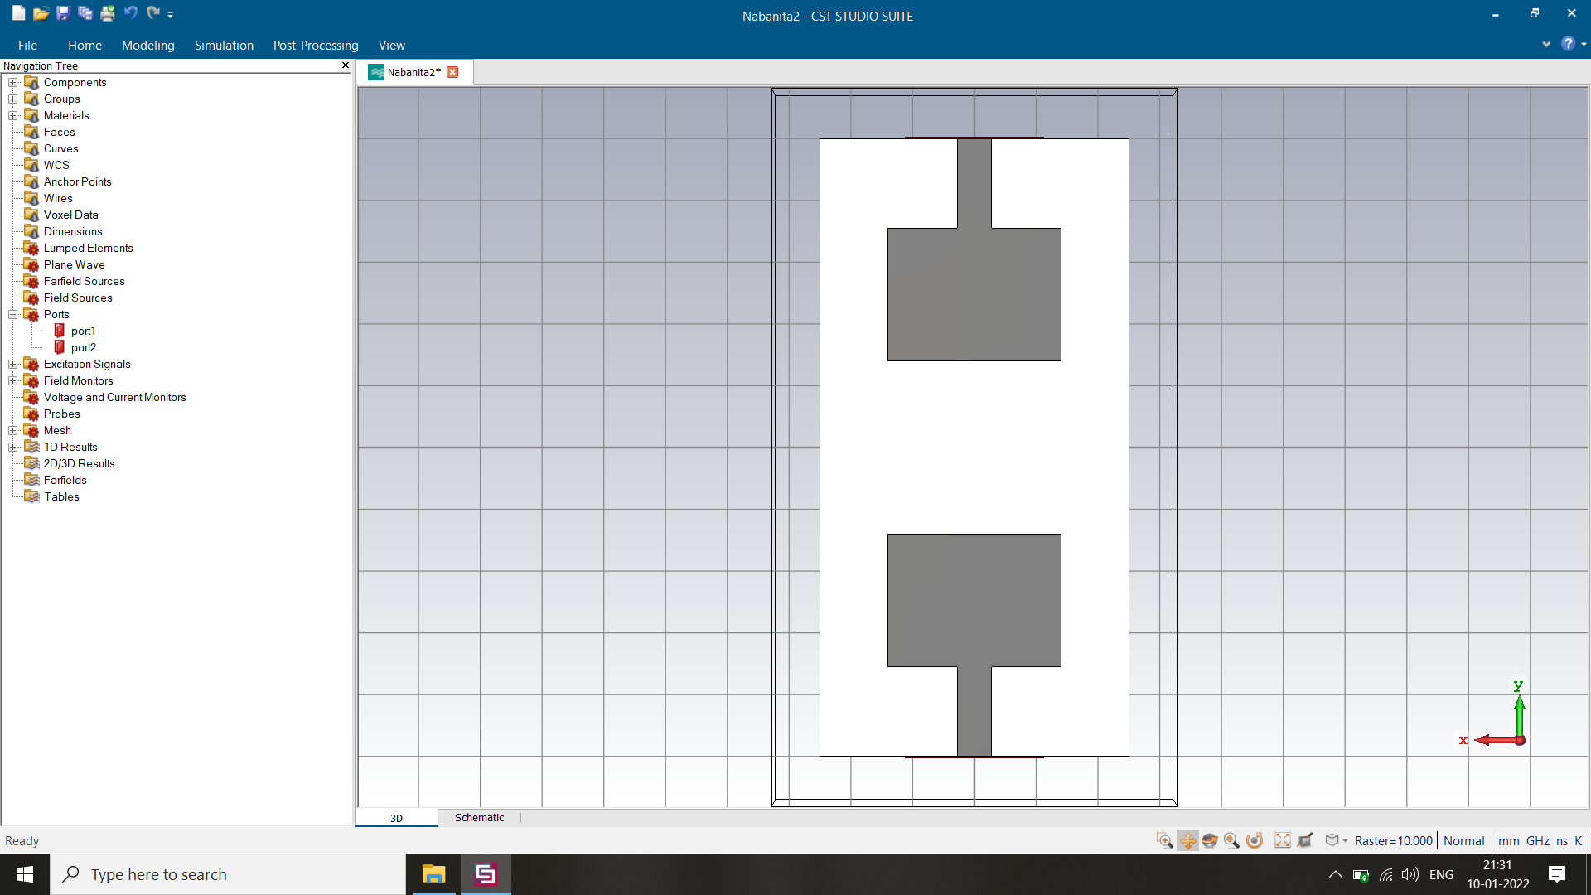
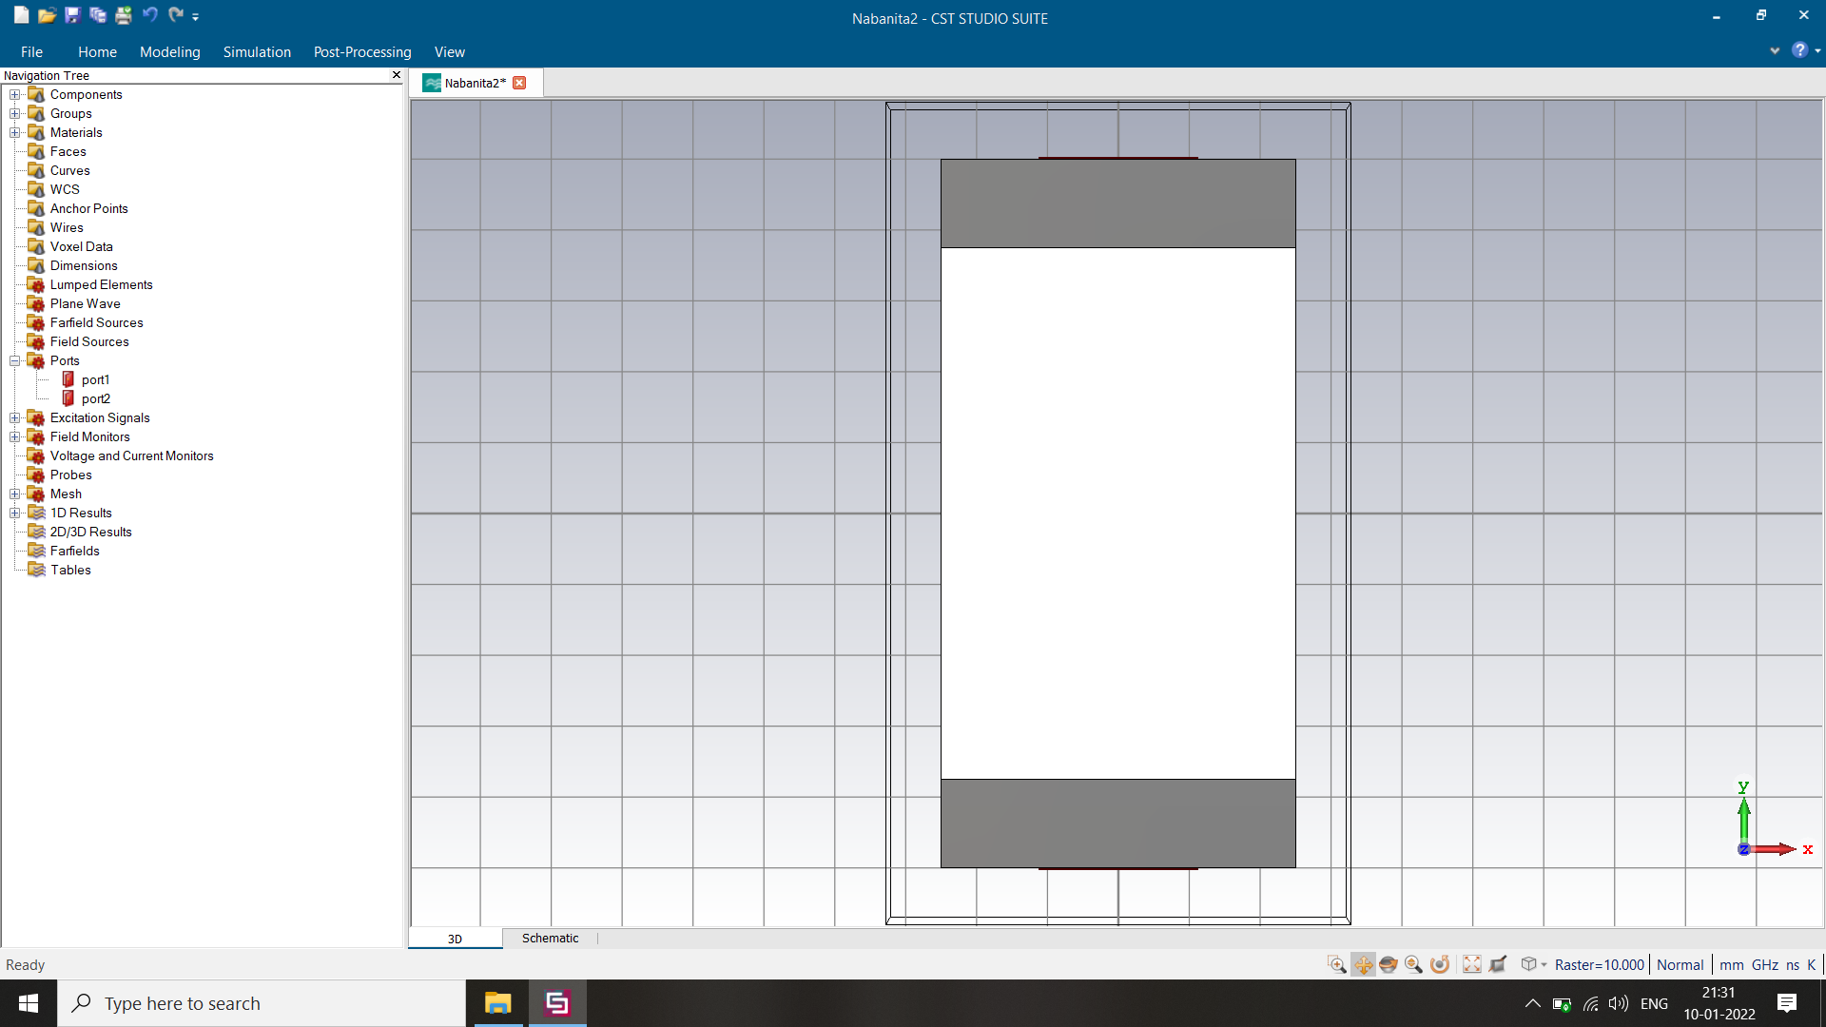
Design 4: Two Monopoles opposite along X axis
Front View
Back View
Operating Band: 2.0838 – 4.1218 GHz
Band Width: 2.038 GHz
Maximum S21: -16 dB
S-parameters

Slide 11
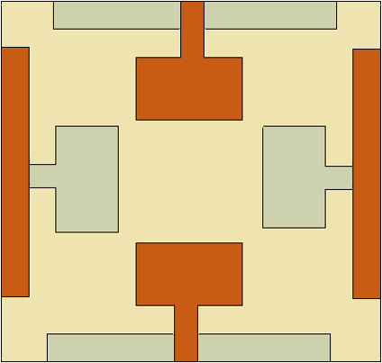
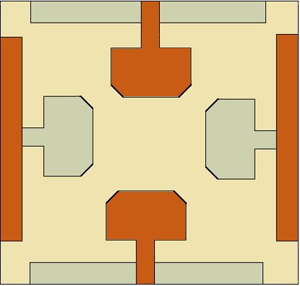
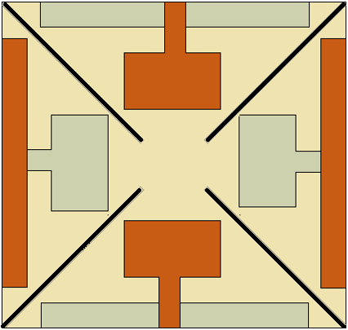
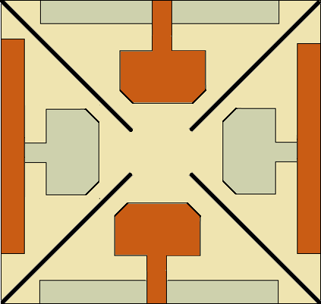
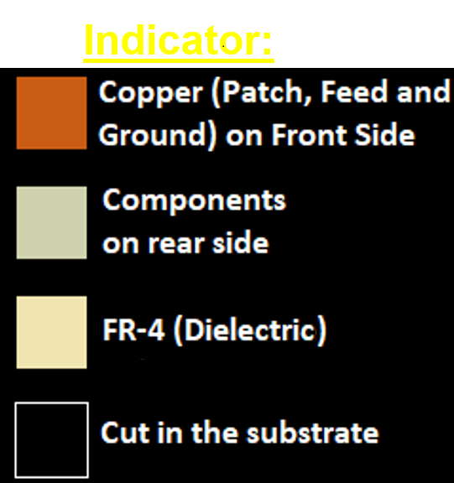
Design Modification
Design Parameters:
Dielectric length =150 mm
Dielectric width =150 mm
Dielectric height =1.6 mm
Patch length =27.922505310634 mm
Patch width =21.484023919693 mm
Patch height =0.035mm
Feed length=14.5 mm
Feed width =5.5845010621268 mm
Cut width=2 mm
Operating Band – (1.4556 – 4.5015) GHz
Band Width – 3.0459 GHz
Percentage bandwidth – 102.2%
Design: A
Design: B
Indicator:
Design: C
Final Proposed Design

Slide 12
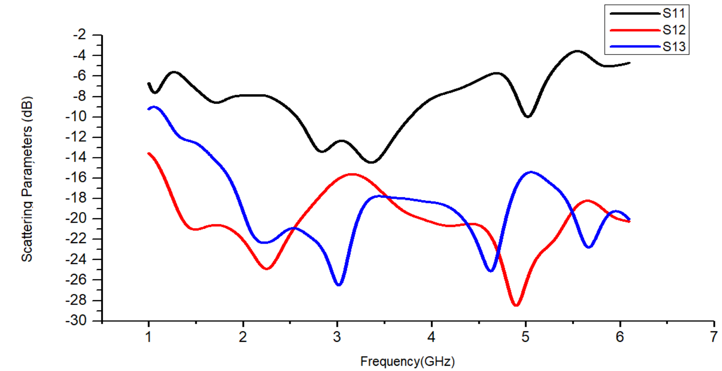
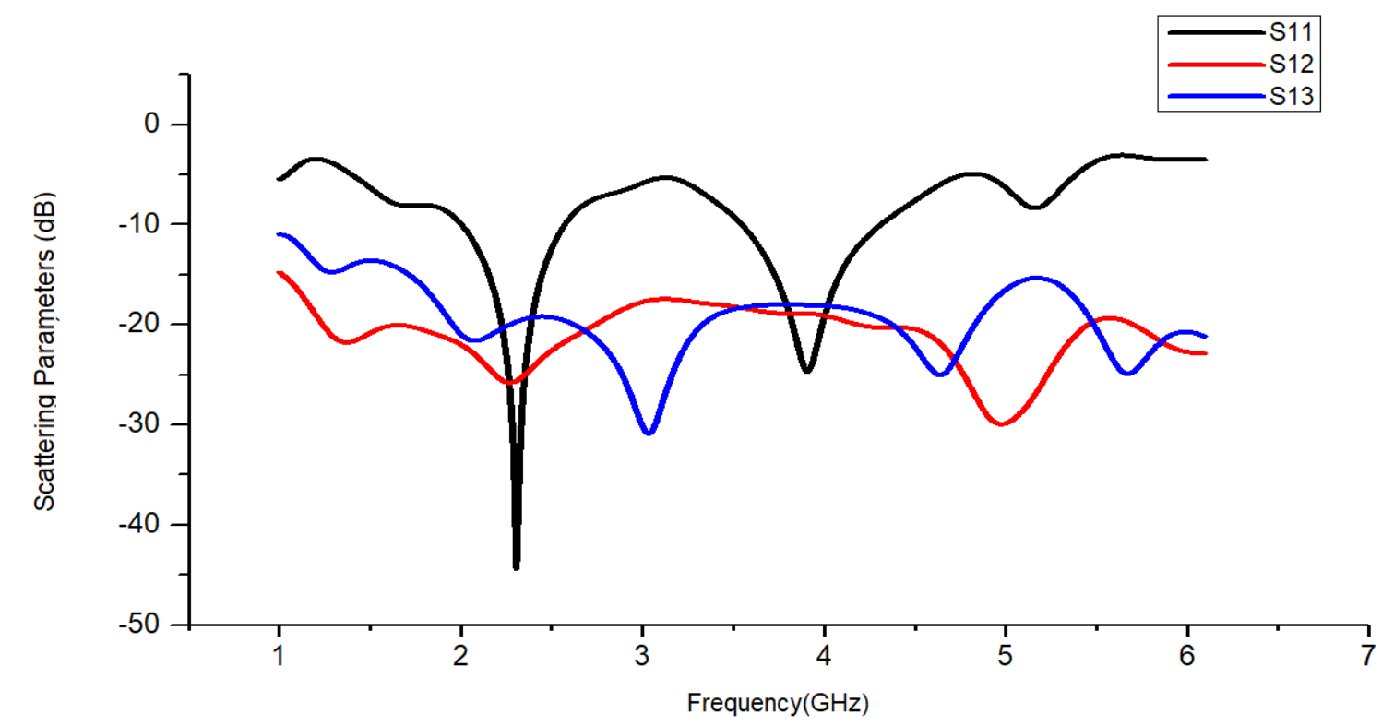
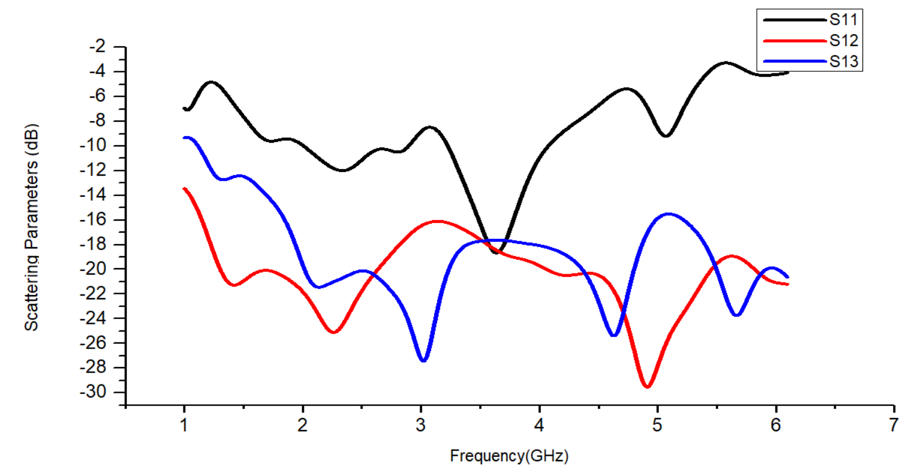
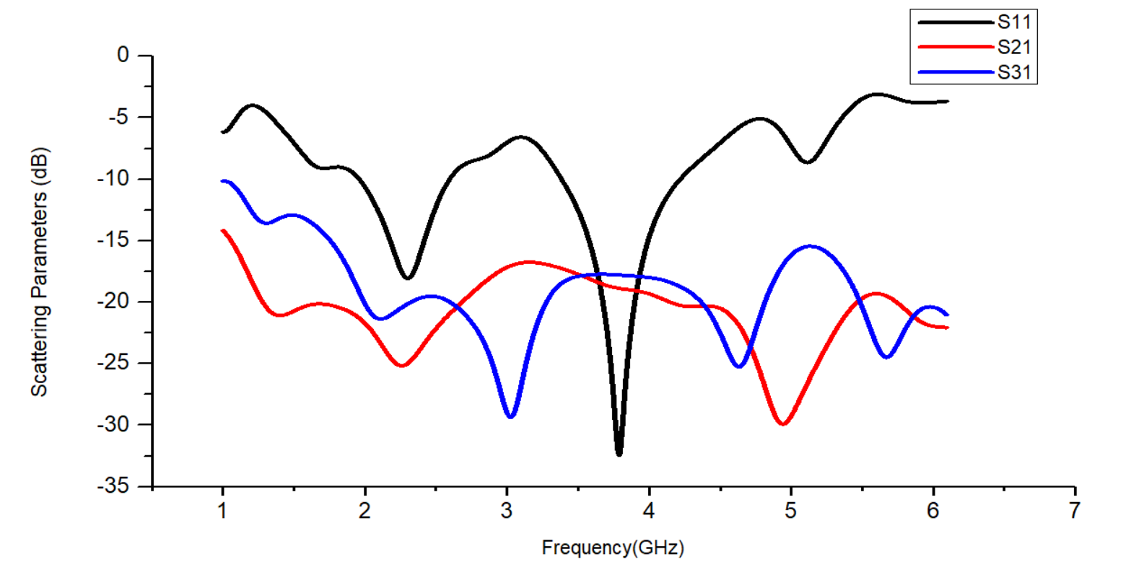
Parametric Studies (design A) : Feed Width Variation
Feed width = W/10
Feed width = W/4
Feed width = W/10
Feed width = W/7.5
Feed width = W/5

Slide 13
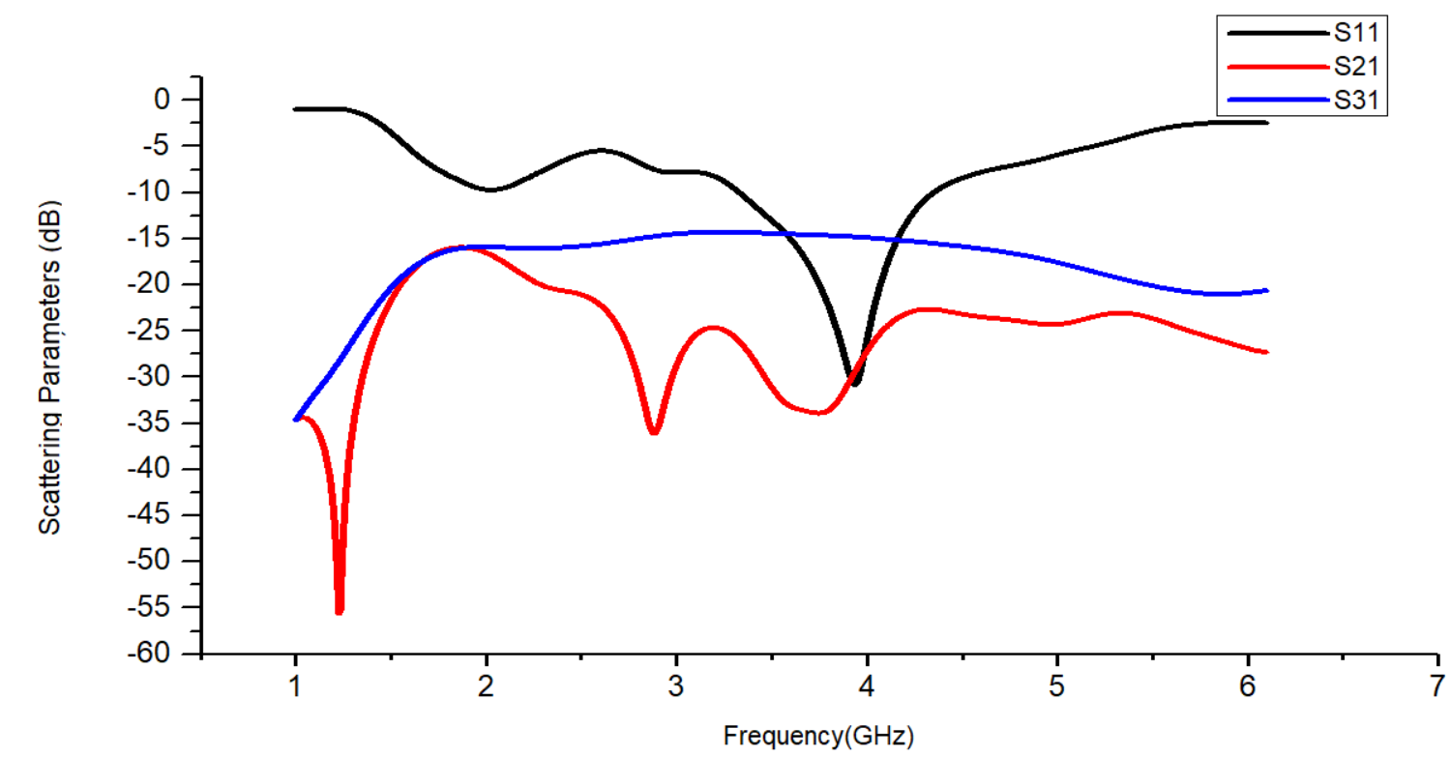
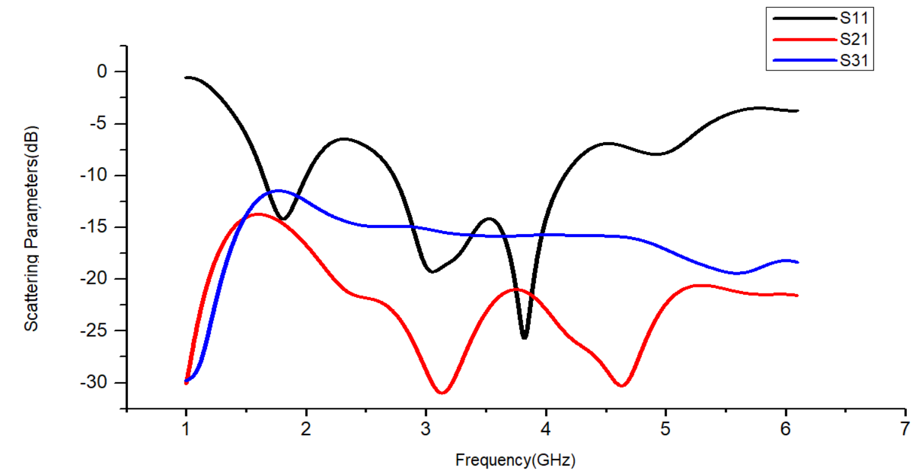
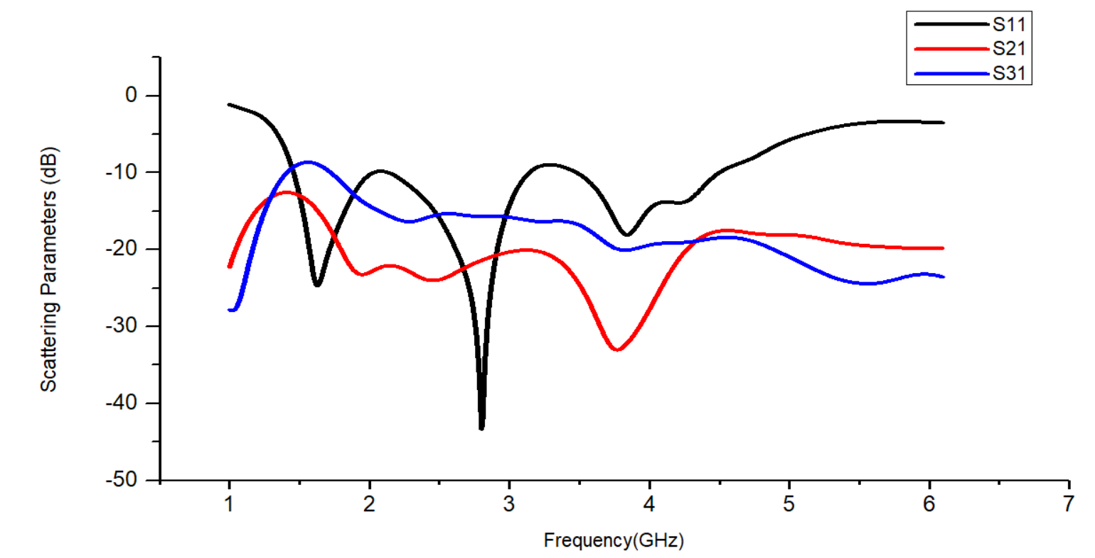
Parametric Studies (design A) : Ground Length Variation
Ground length = L/2
Ground length = L/1.5
Ground length = L
Ground length = L – 28

Slide 14
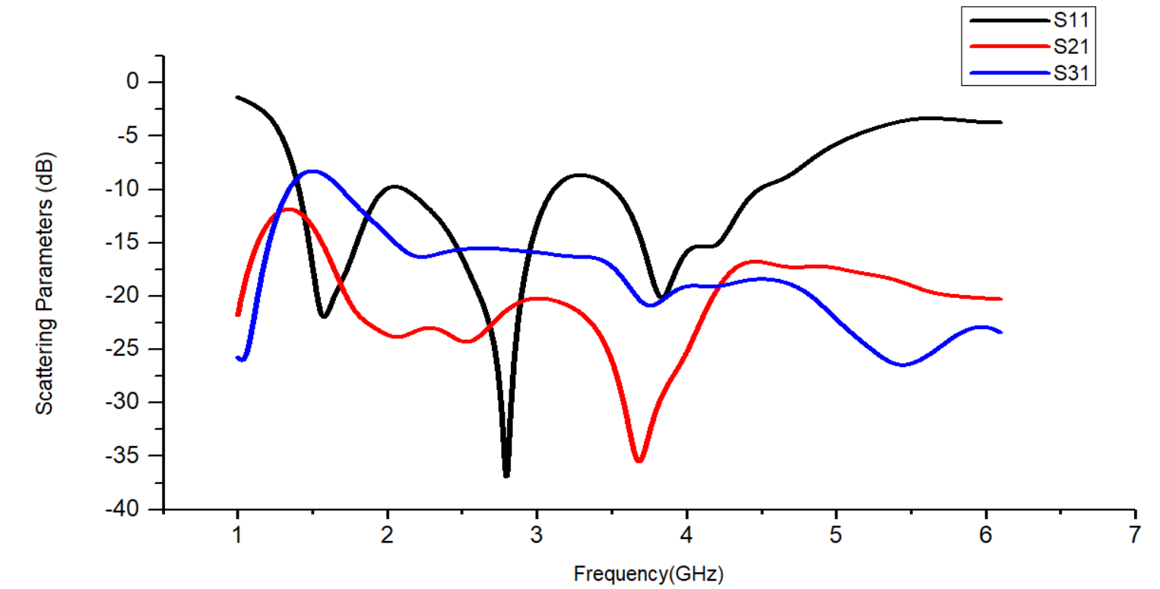
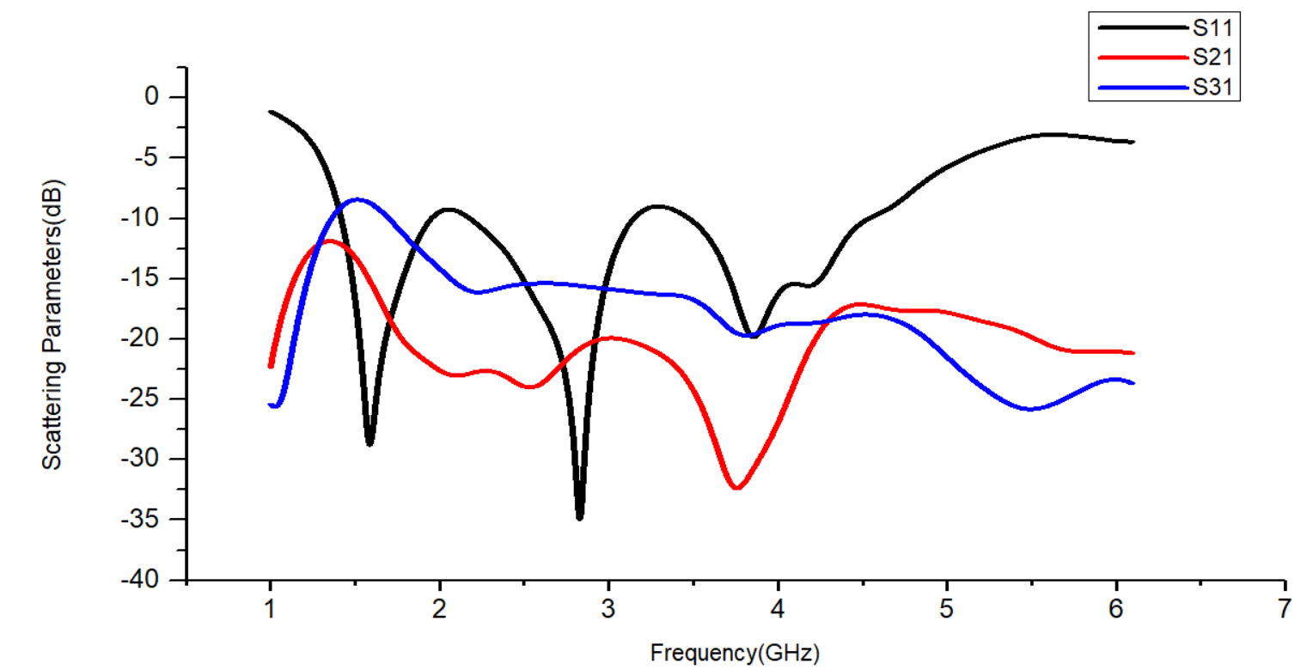
Comparison of S Parameters for Respective Design Modifications
Design A
Design B
1)
2)
Design C
Final Proposed Design
3)
3)
4)

Slide 15
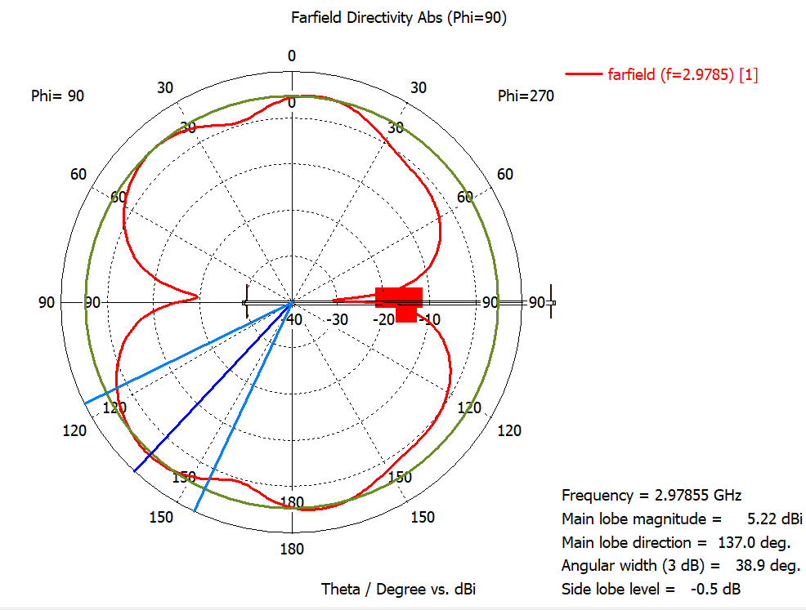
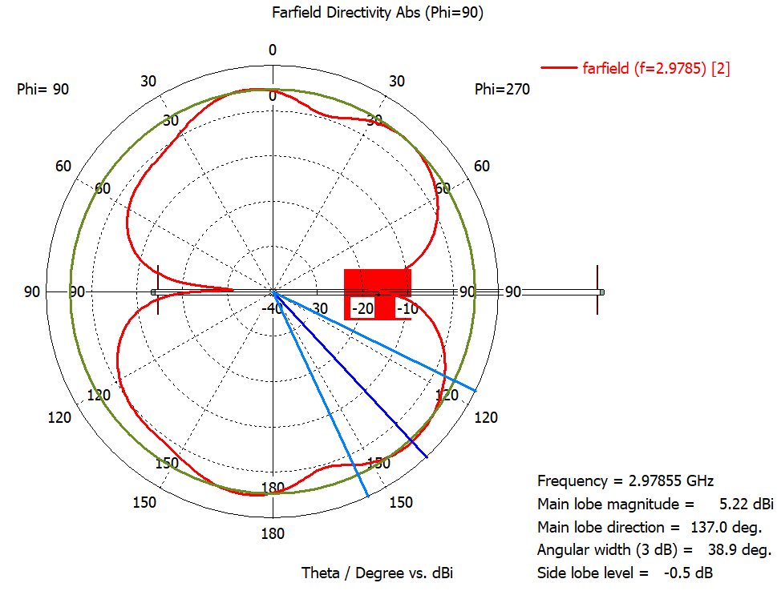
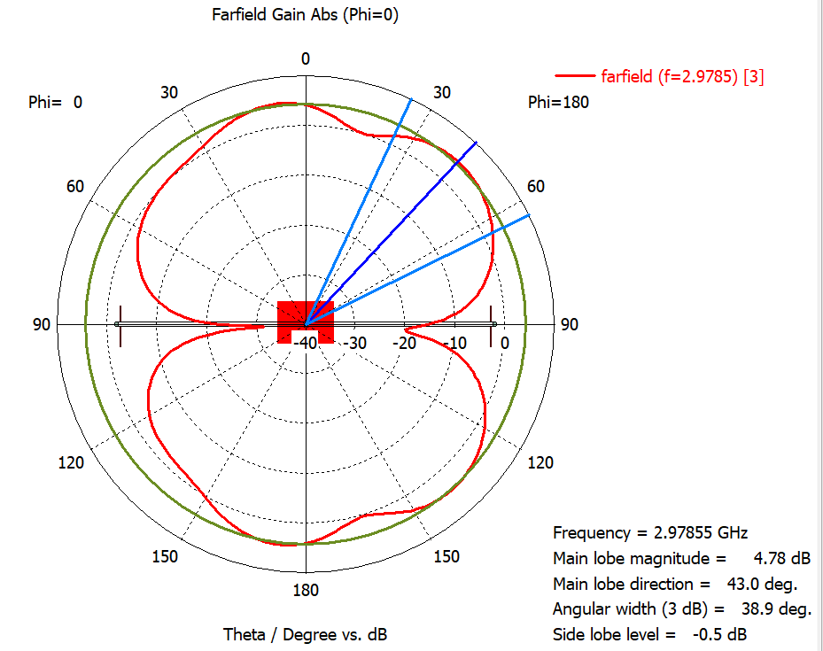
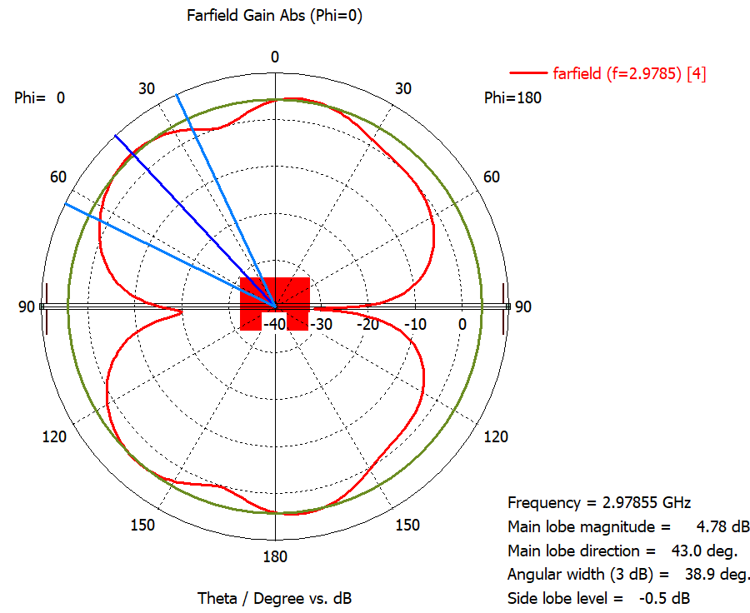
Radiation
Pattern
Port 1
Port 2
Port 3
Port 4

Slide 16
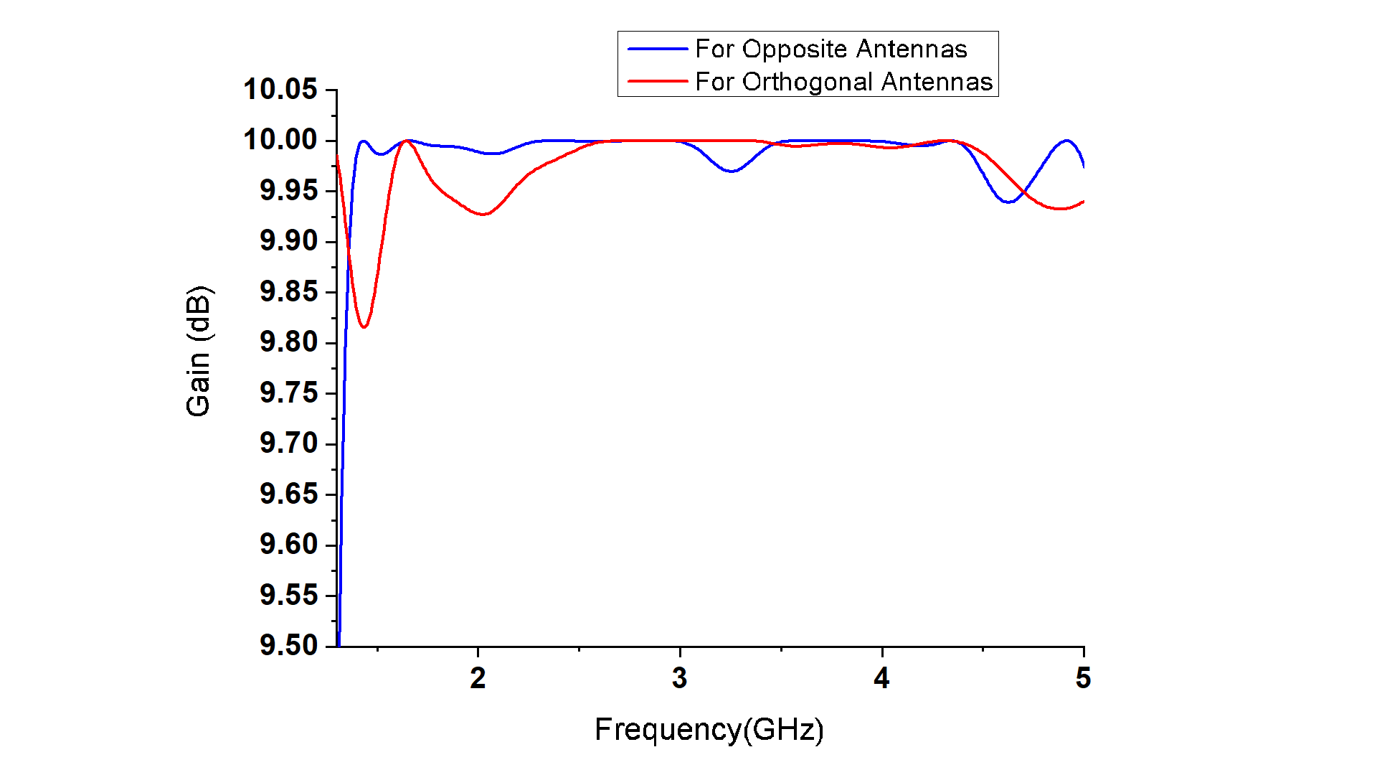
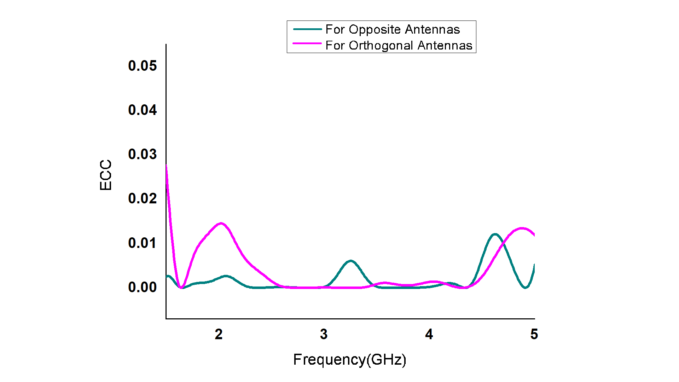
Diversity
Gain
Envelope
Correlation
Coefficient
1.4

Slide 17
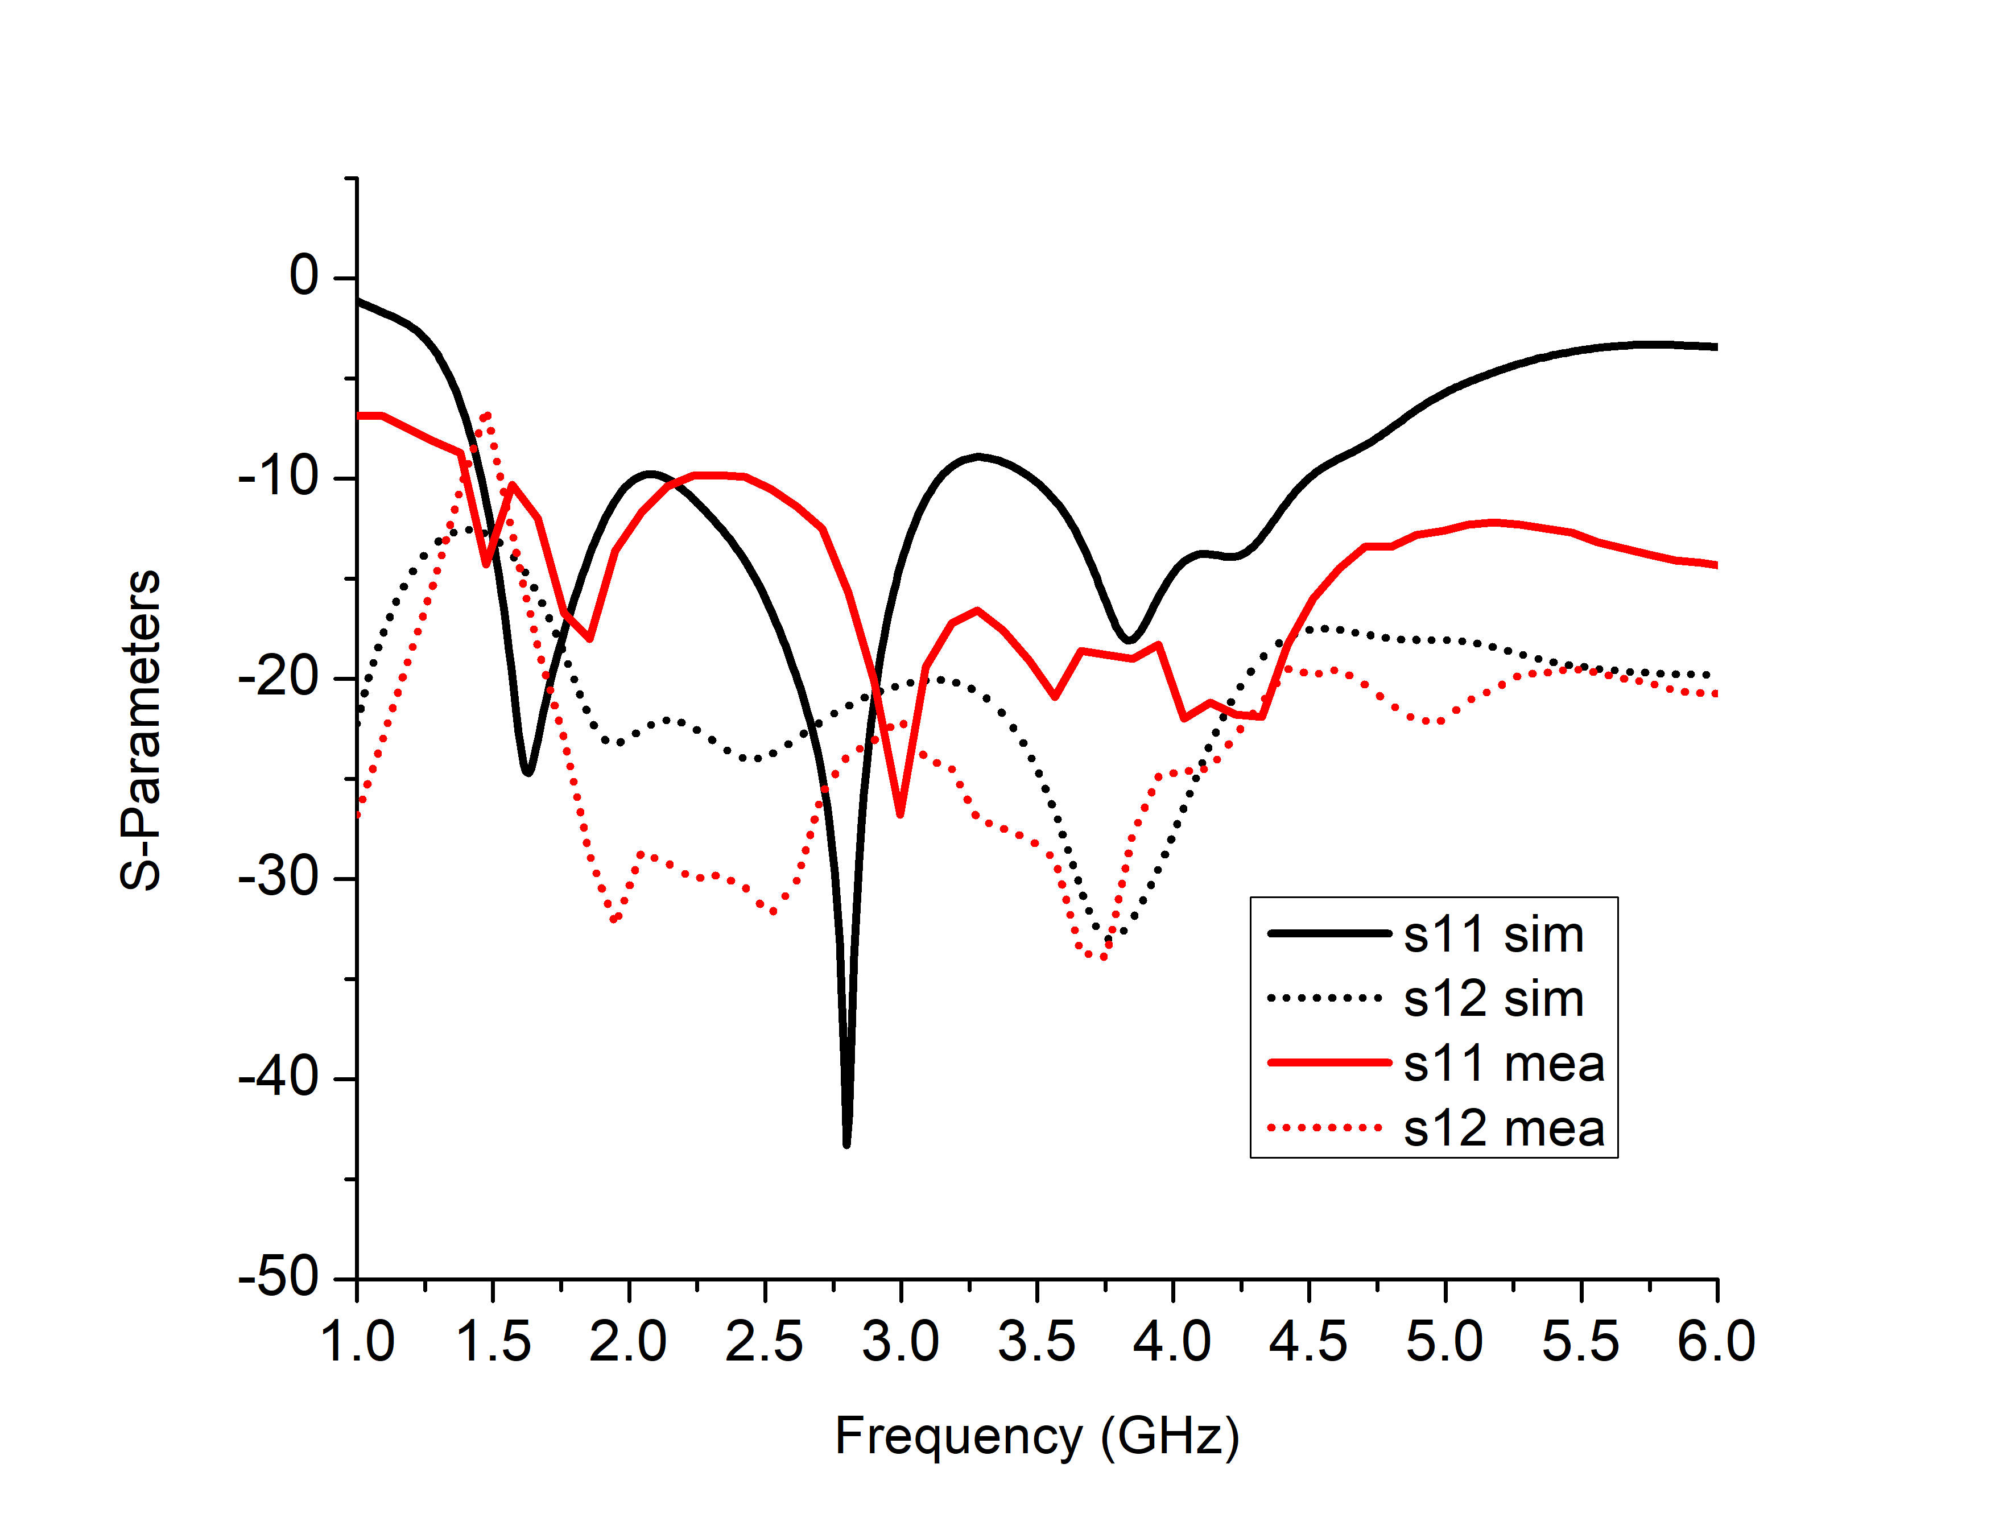
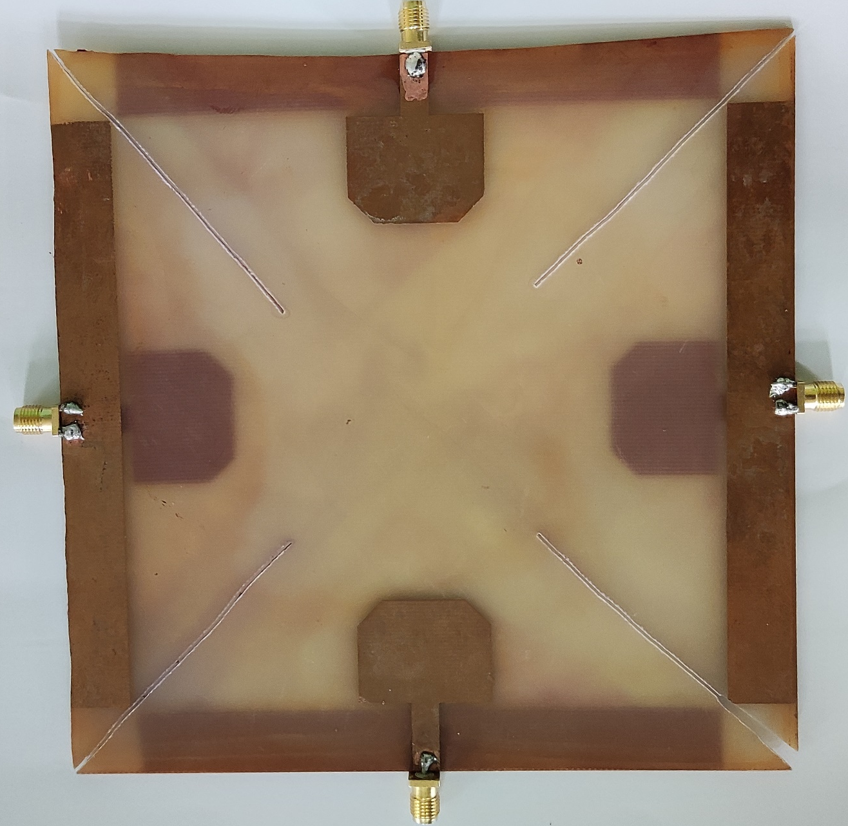
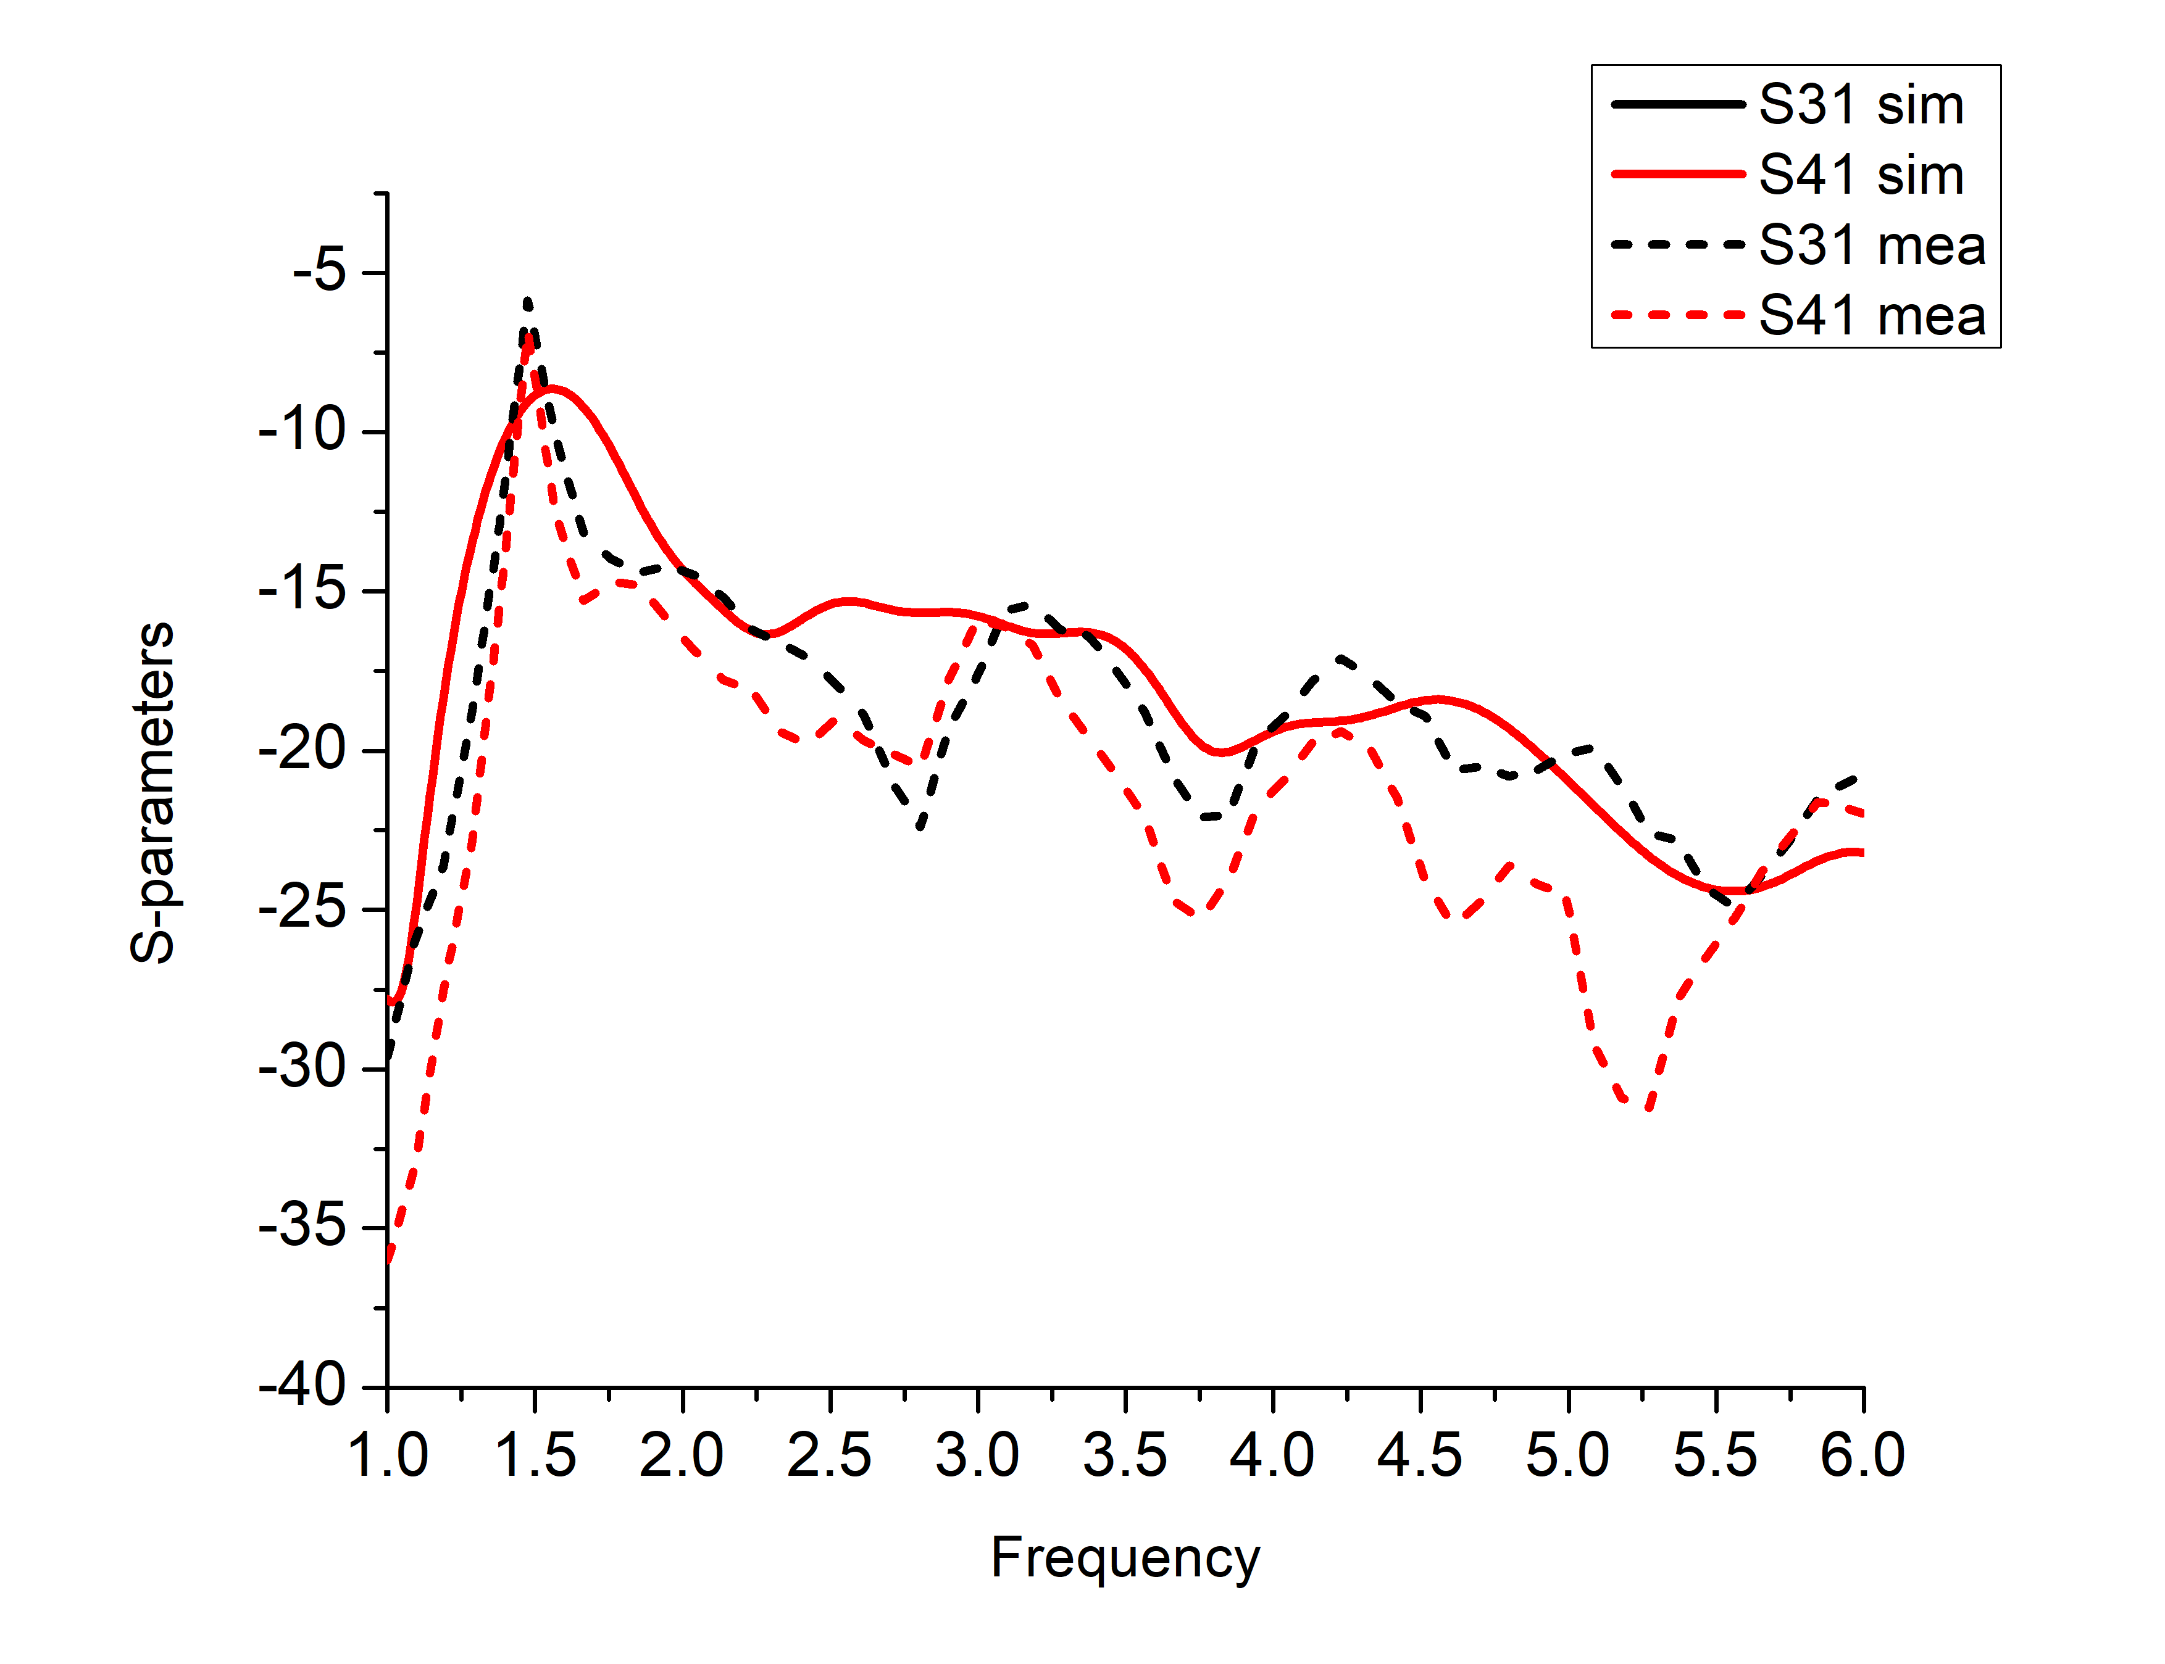
Fabricated Prototype and Measured Results
Copper Patch
on Front Side
Ground
1
Comparison Between Simulated
and
Measured Results of
S-Parameters
Copper Patch
on Rear Side
3
4
2
Cuts
SMA Connectors
Fabricated Antenna

Slide 18
Thank
you!

